Slide 1
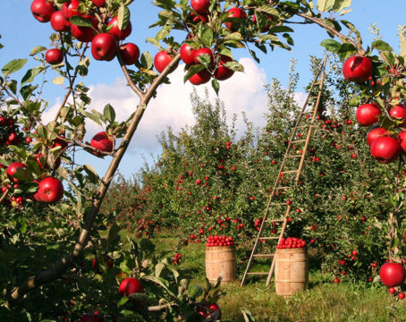
Fruit Detection UCRG Summer Research Forum
Sarah Dinh

Slide 2
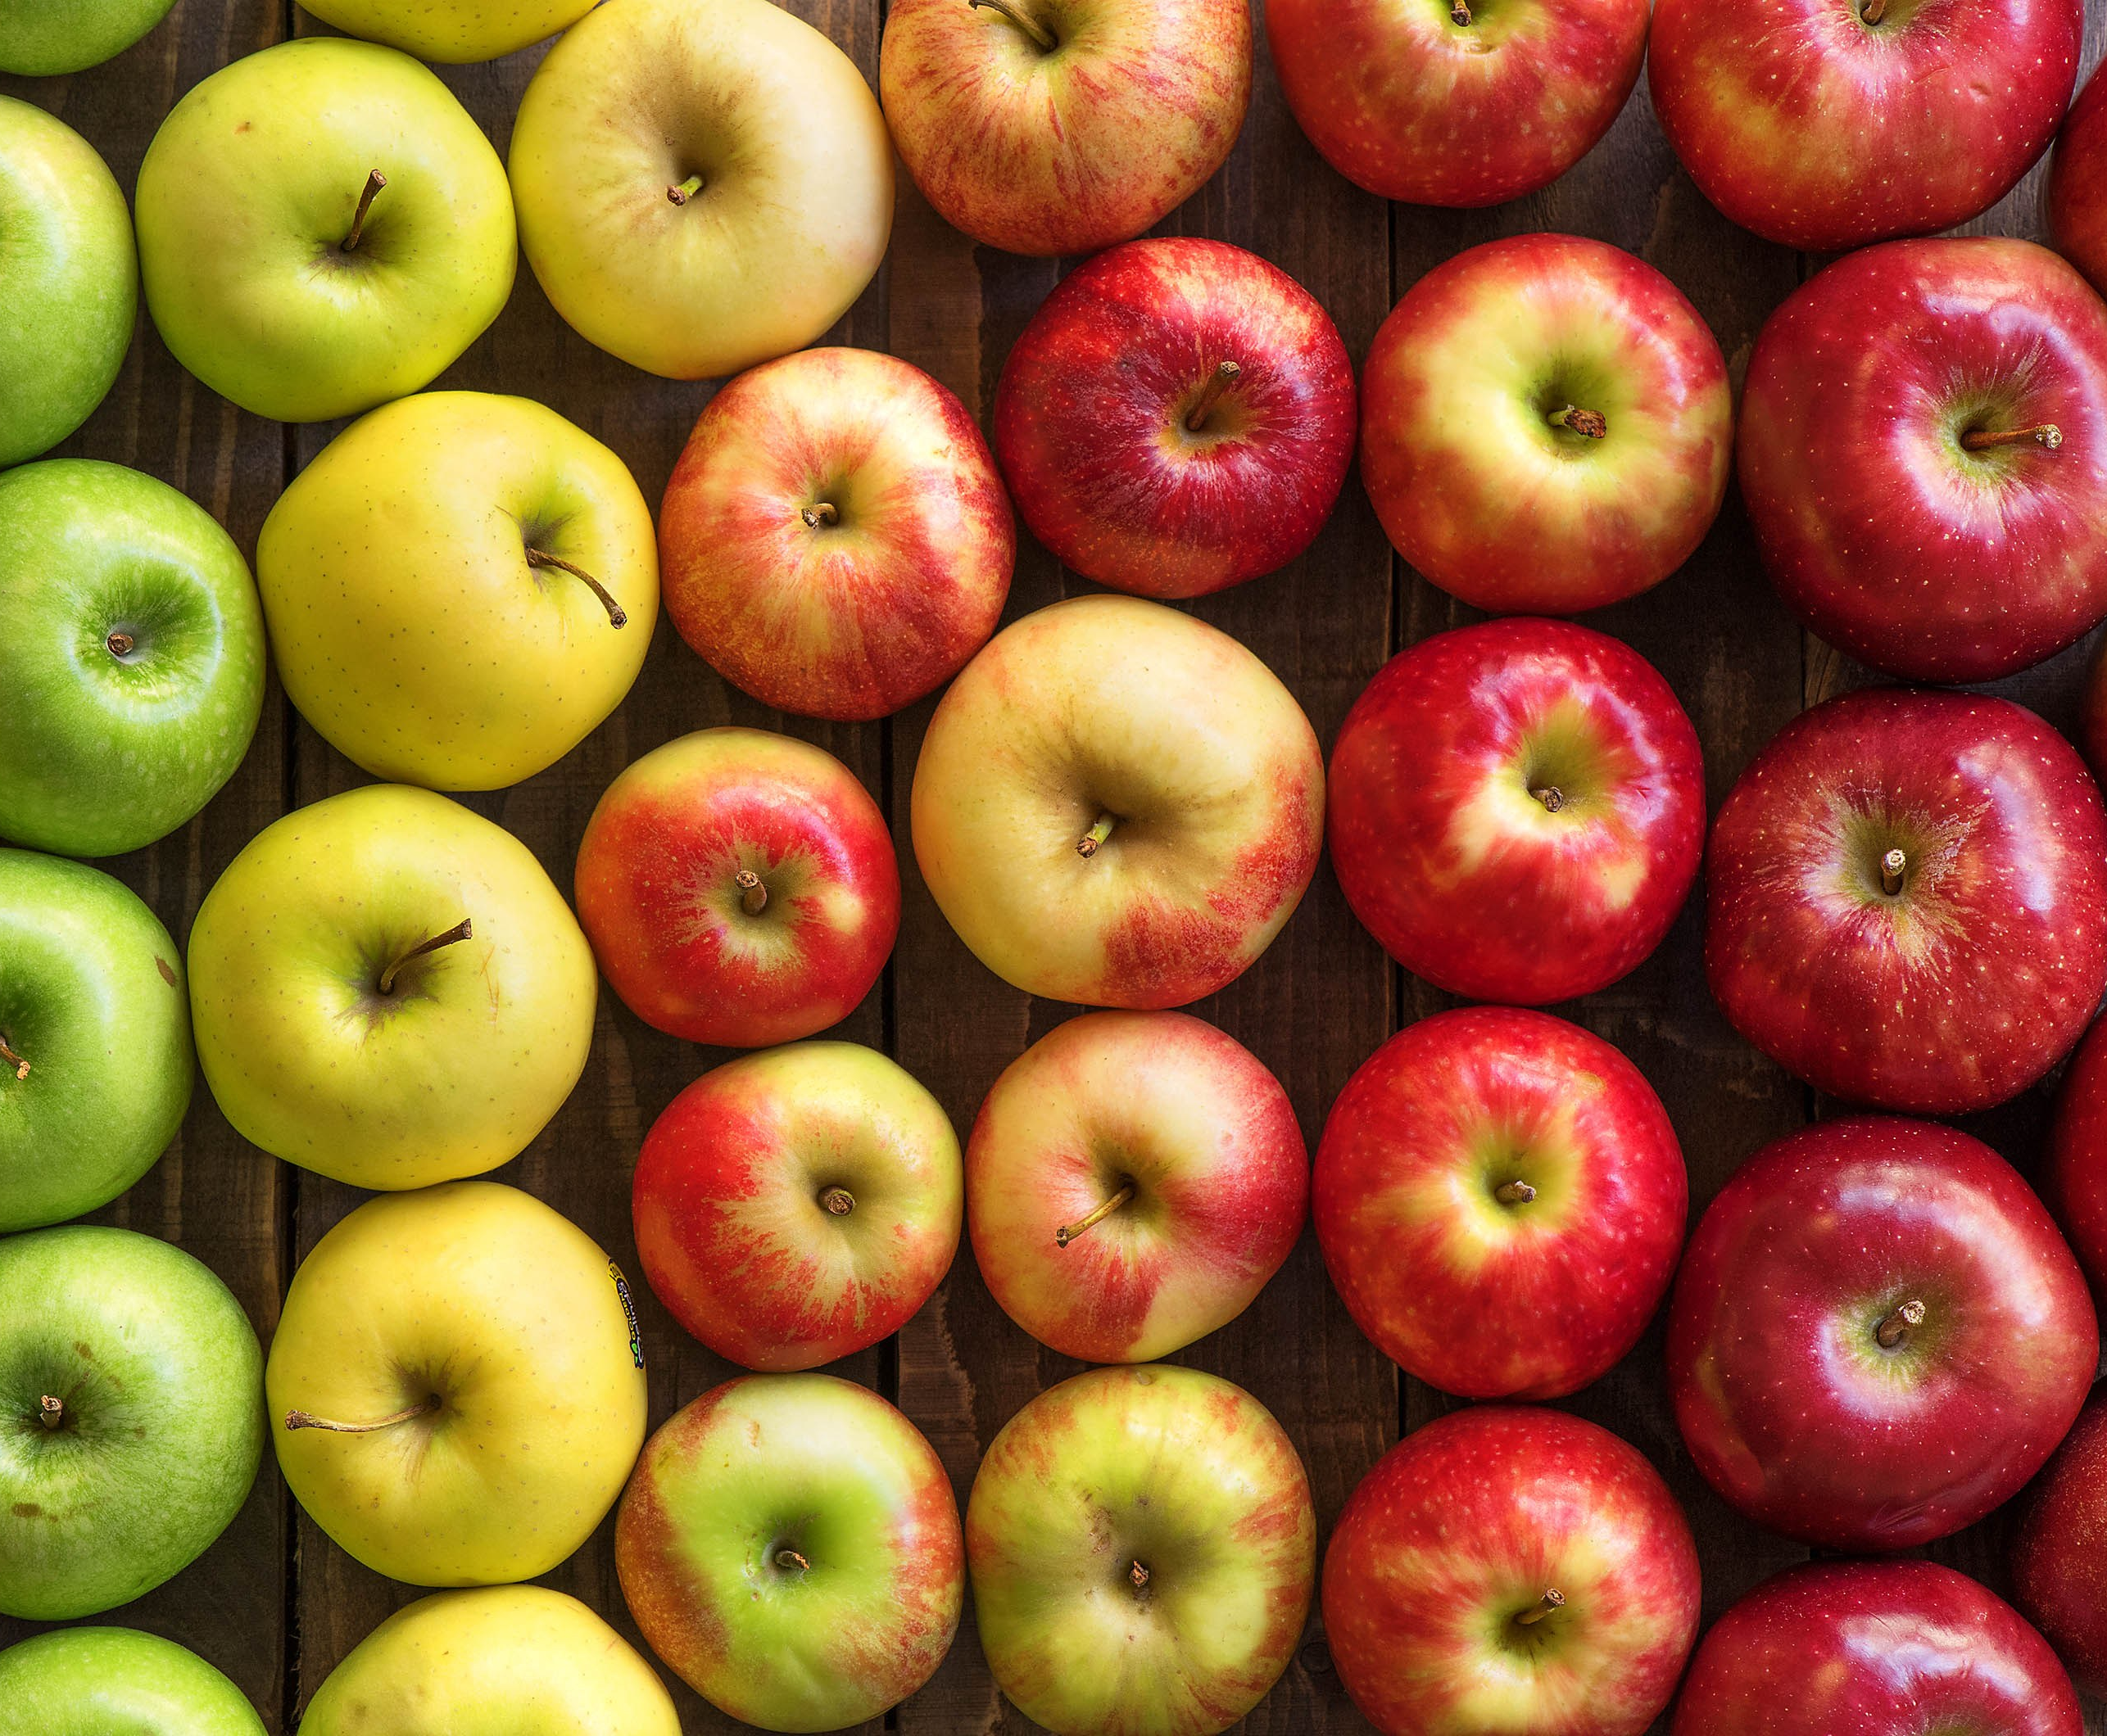
Project Scope
Detect one type of fruit from a fruit tree in an outdoor setting
Conditions
Red apples
Fruits are within reach
Detect aged/ripe fruits only

Slide 3
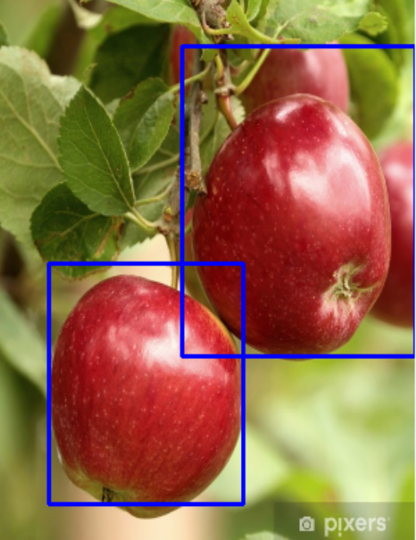
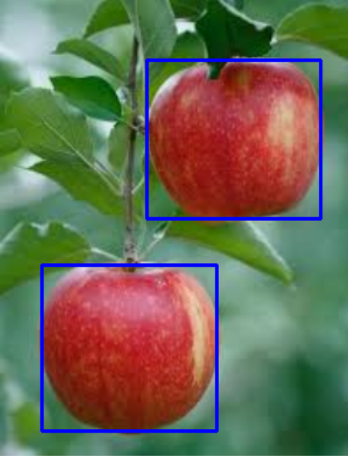
Solution
Functions
Colour Mask
Glare Reduction
Shape Contours

Slide 4
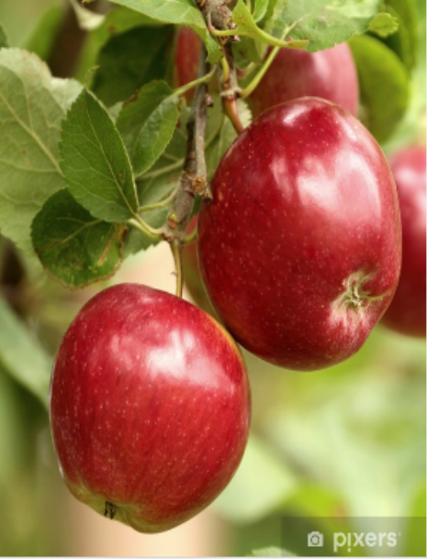
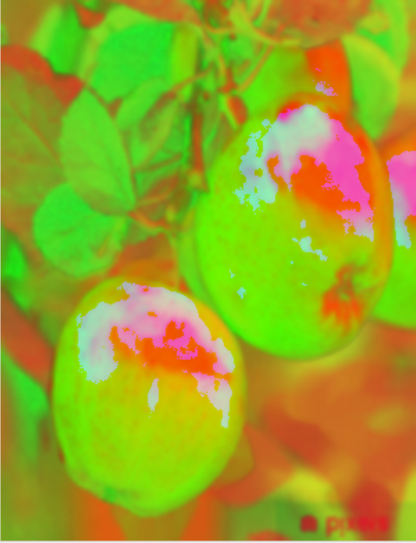
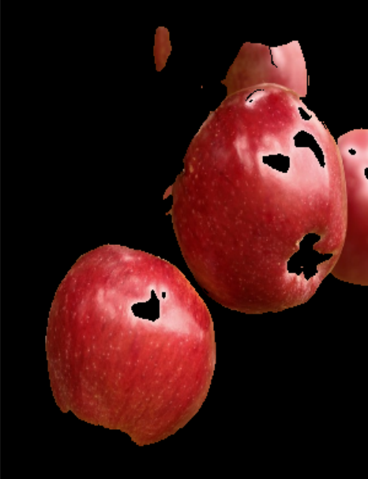
Functions
Color Mask
RGB vs HSV

Slide 5
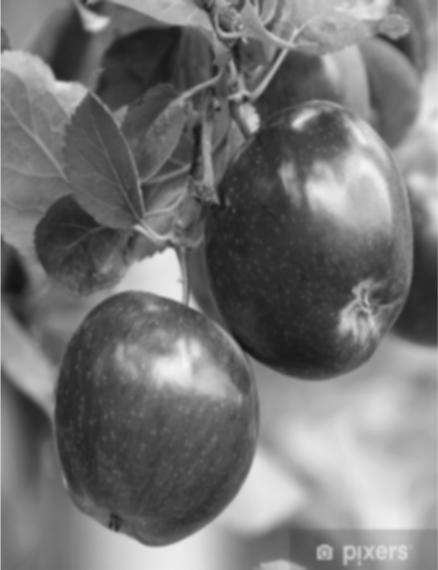
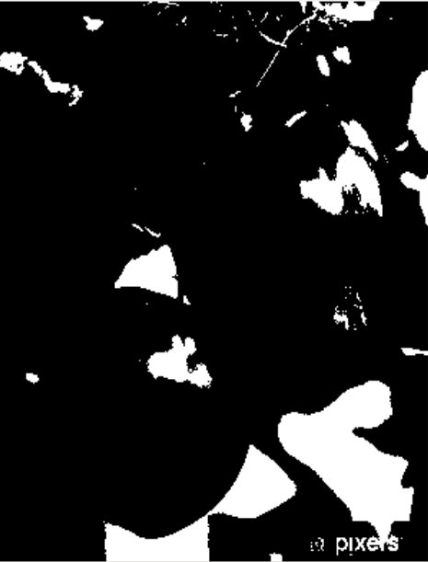
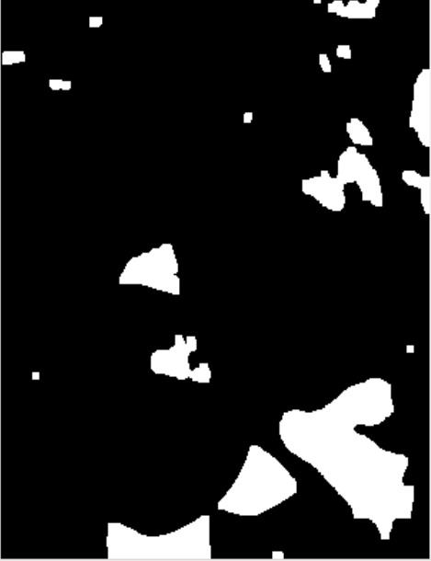
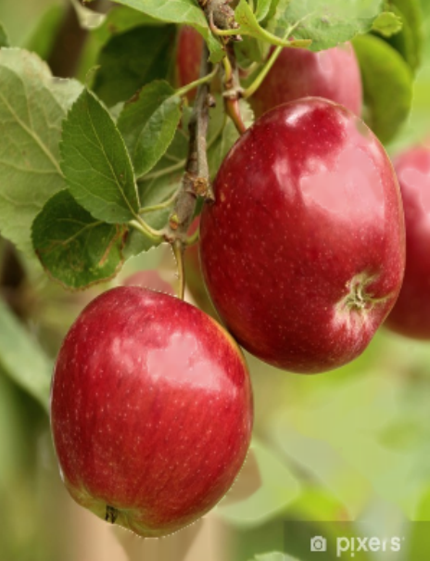
Functions
Glare Reduction
Grayscale image and Gaussian blur
Threshold
Erosion and Dilation (noise reduction/further highlight bright areas)
InPaint Naiver-Stokes

Slide 6
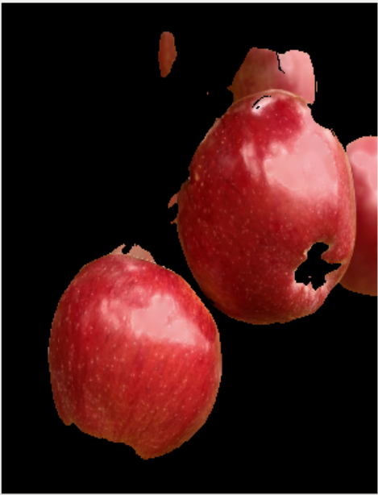
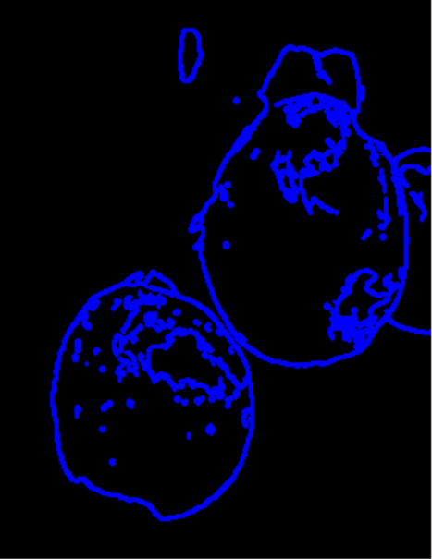
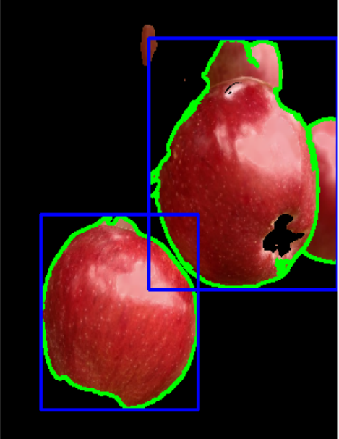
Functions
Shape Contours
Canny Edge Detection
Area/arc length of contour to eliminate smaller contours
Contour shape detection through vertices

Slide 7
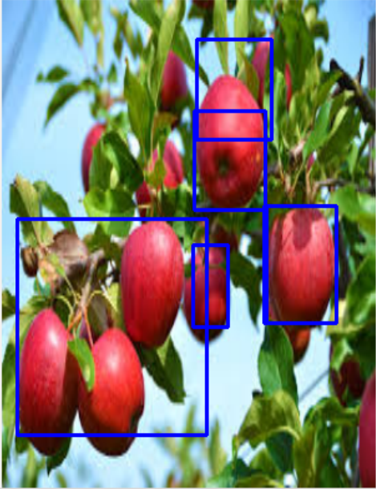
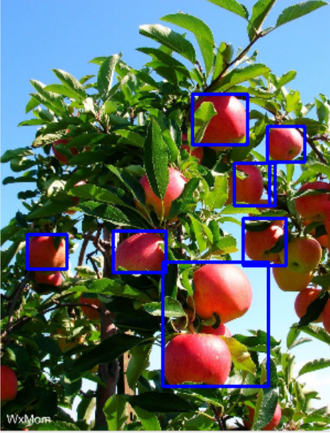
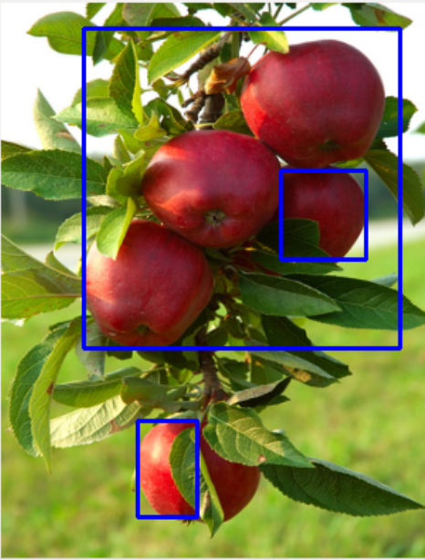
Combined Implementation

Slide 8
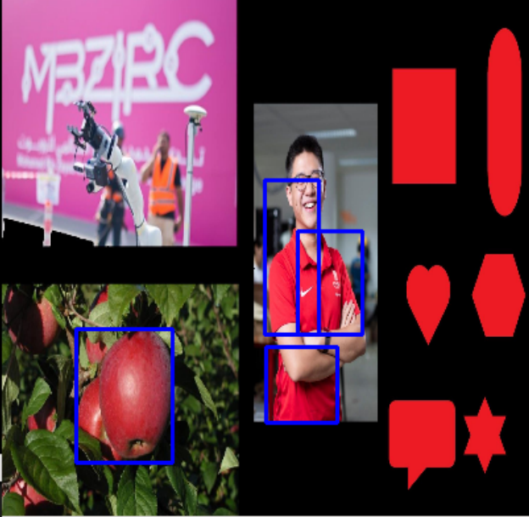
Object Differentiation

Slide 9
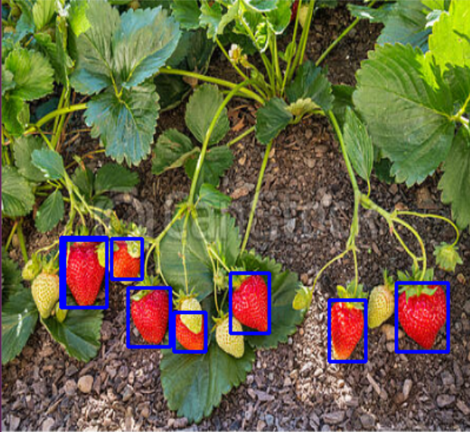
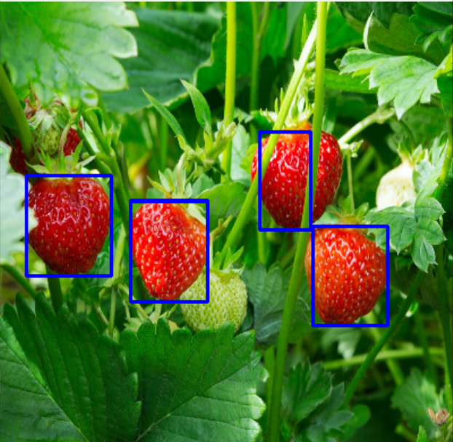
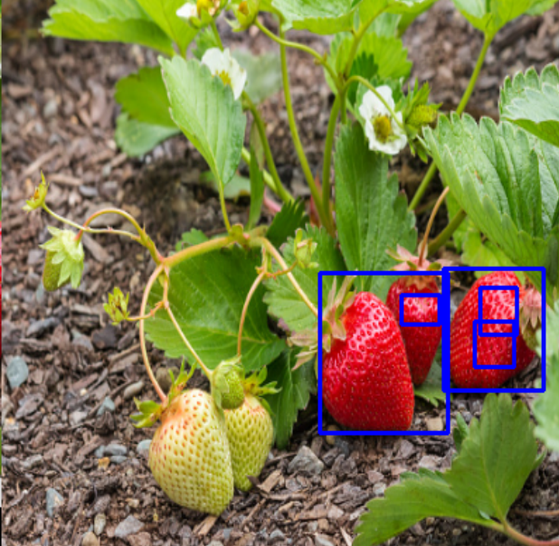
Application on another red fruit
Strawberry skin texture

